Slide 1

Carson Street Japanese Restaurant Yelp Review Analysis

Slide 2
About
The data used for this analysis is from Yelp.

Slide 3
Column Explanation
name: Name of the reviewer
city: City where the reviewer is from
state: State where the reviewer is from
ratings: Number of stars given by the reviewer
reviews: Review written by the reviewer
date: Date when the review was written
month: Month when the review was written
year: Year when the review was written
review_length: Number of characters in the review
ratings_info: ratings of 4 or 5 = good, ratings of 1, 2 or 3 = bad

Slide 4
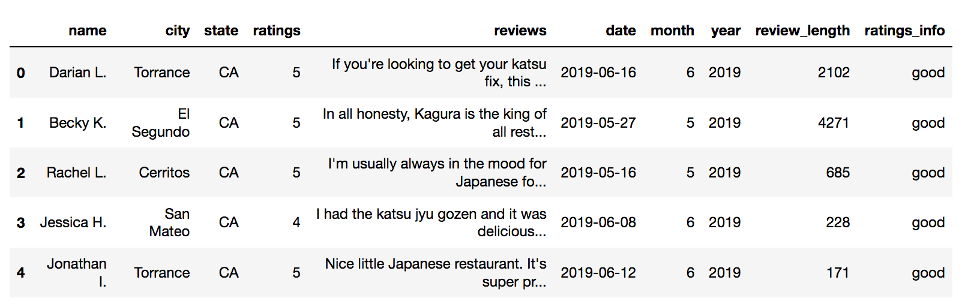
Kagura
https://www.yelp.com/biz/kagura-torrance

Slide 5
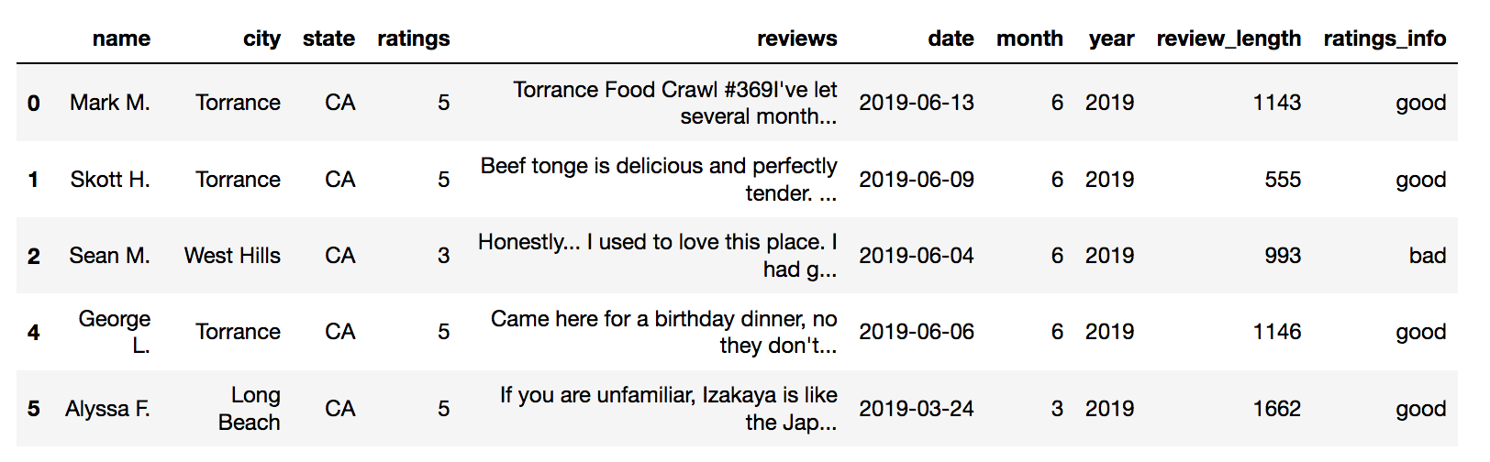
Hachi
https://www.yelp.com/biz/izakaya-hachi-torrance

Slide 6
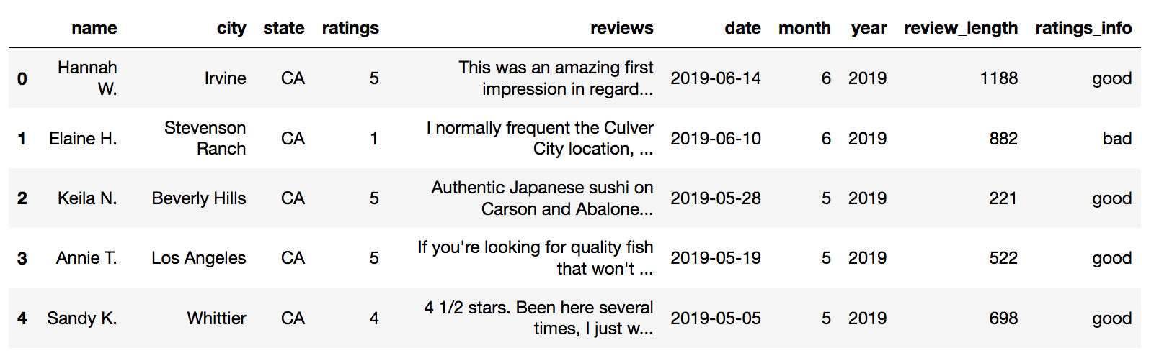
Wadatsumi
https://www.yelp.com/biz/wadatsumi-torrance

Slide 7
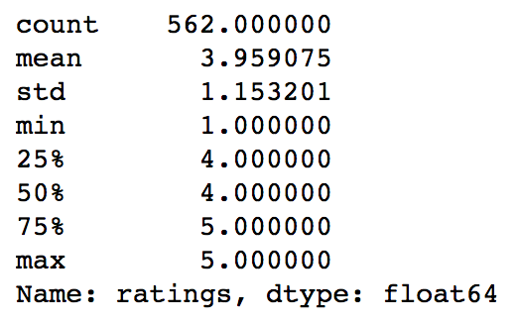
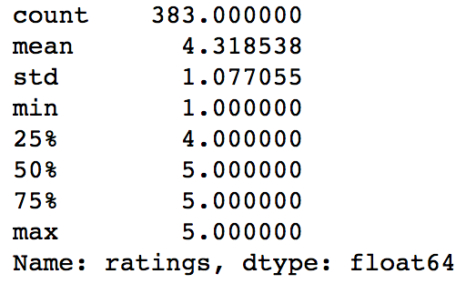
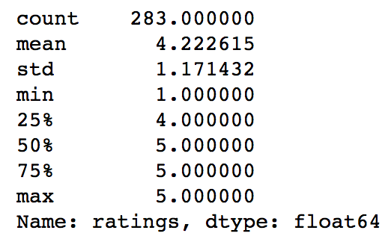
Ratings Statistics
Kagura
Hachi
Wadatsumi

Slide 8
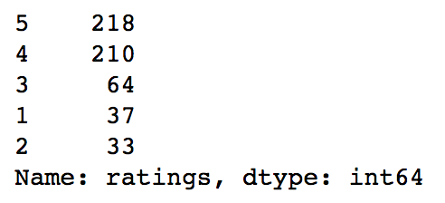
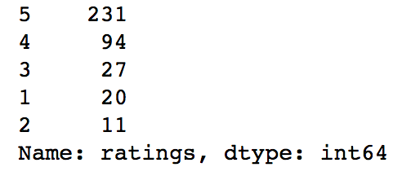
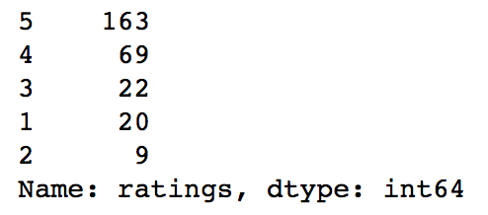
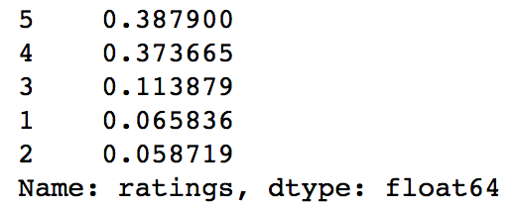
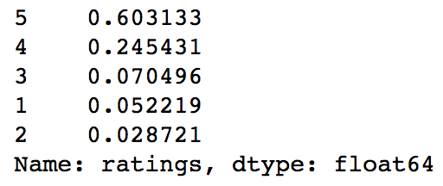
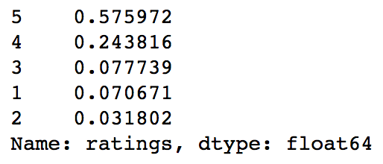
Ratings Count and Ratio
Kagura
Hachi
Wadatsumi

Slide 9
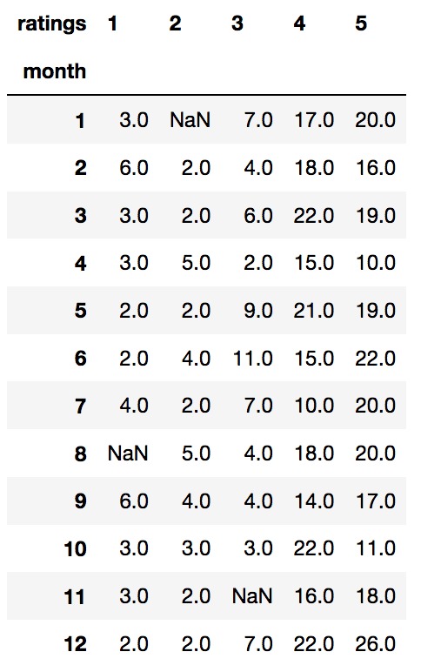
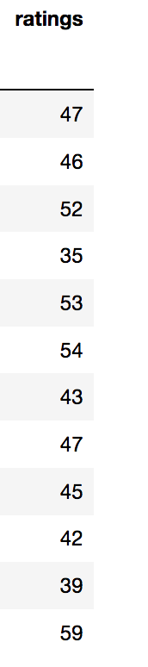
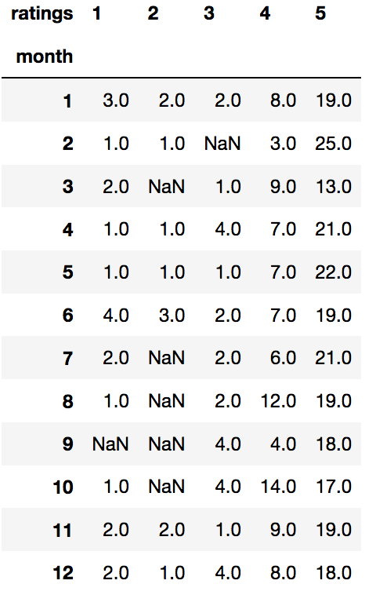
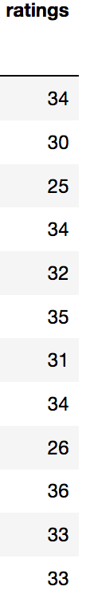
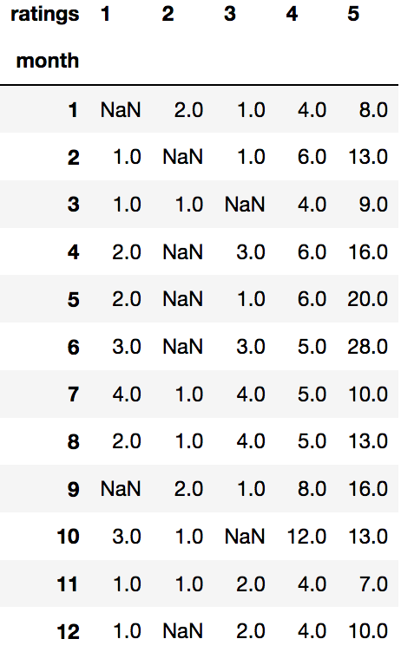

Ratings by Month
Kagura
Hachi
Wadatsumi

Slide 10
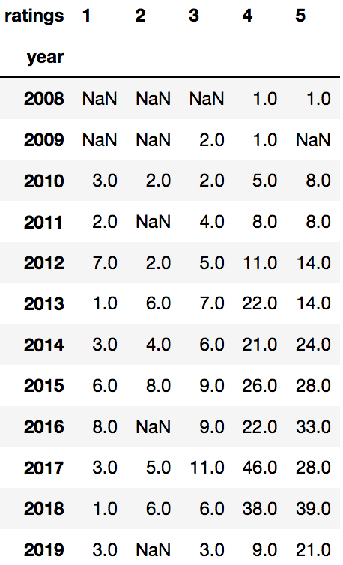
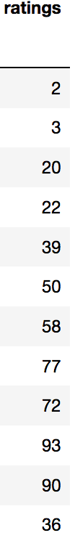
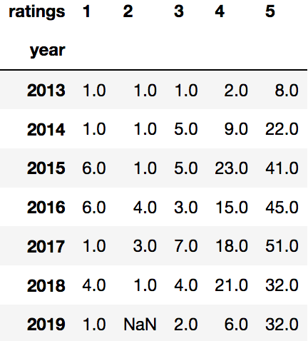

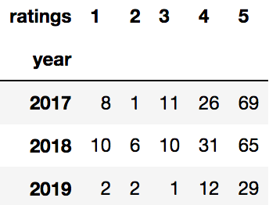
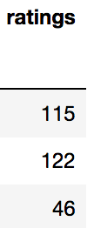
Ratings by Year
Kagura
Hachi
Wadatsumi

Slide 11
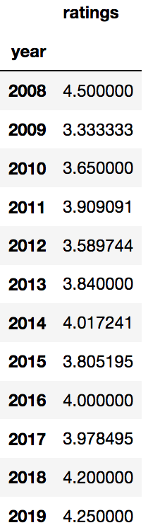
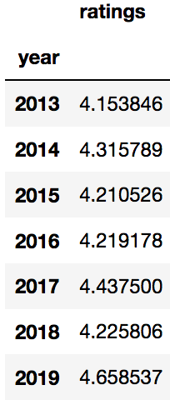
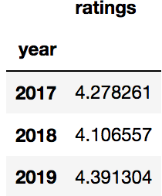
Average Ratings by Year
Kagura
Hachi
Wadatsumi

Slide 12
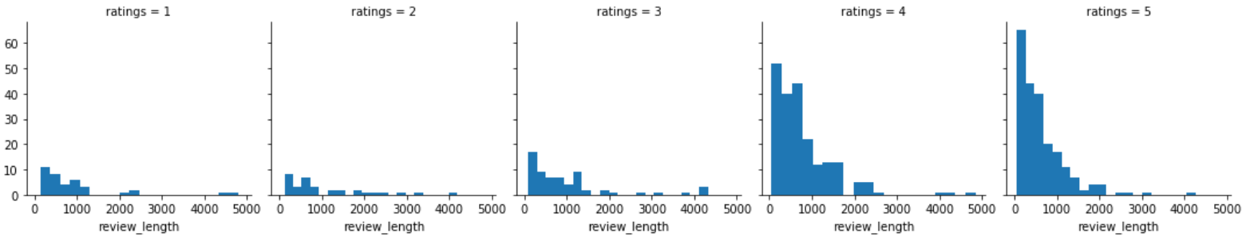
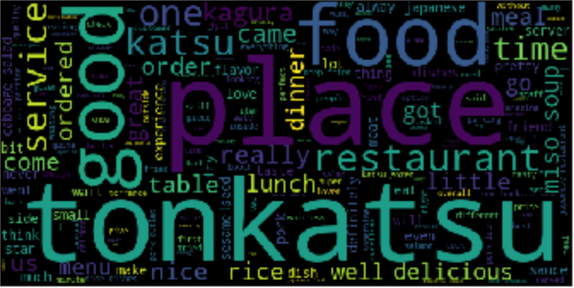
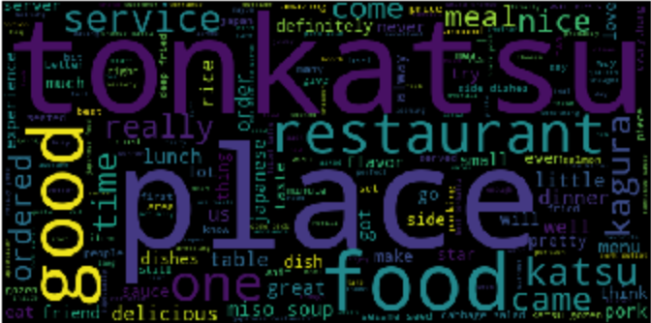
Kagura Review

Slide 13
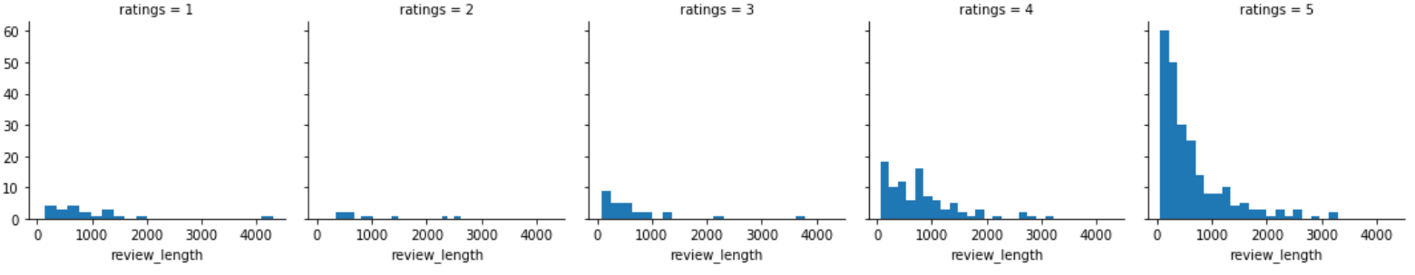
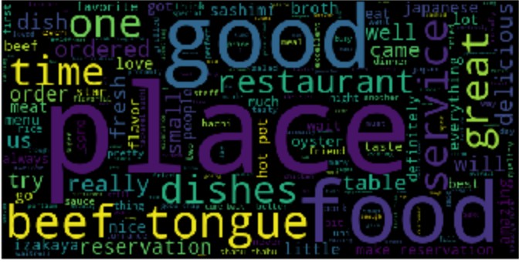
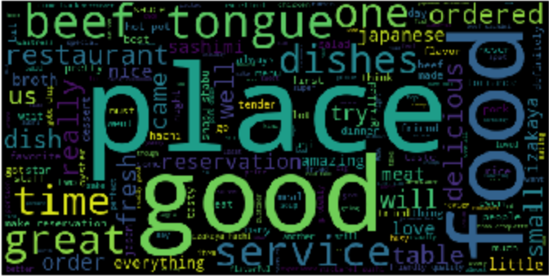
Hachi Review

Slide 14
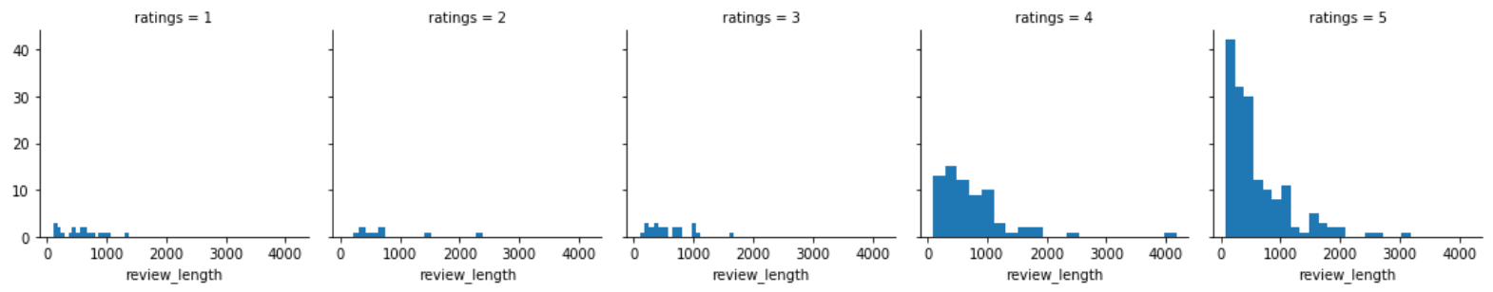
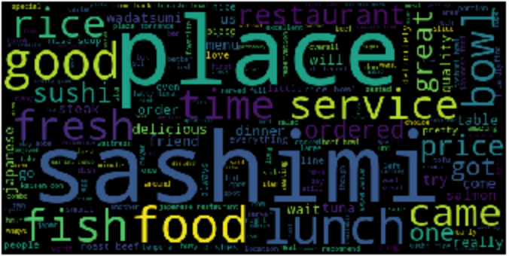
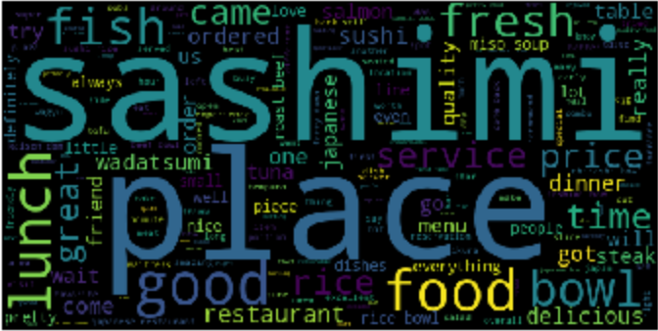
Wadatsumi Review

